Slide 1
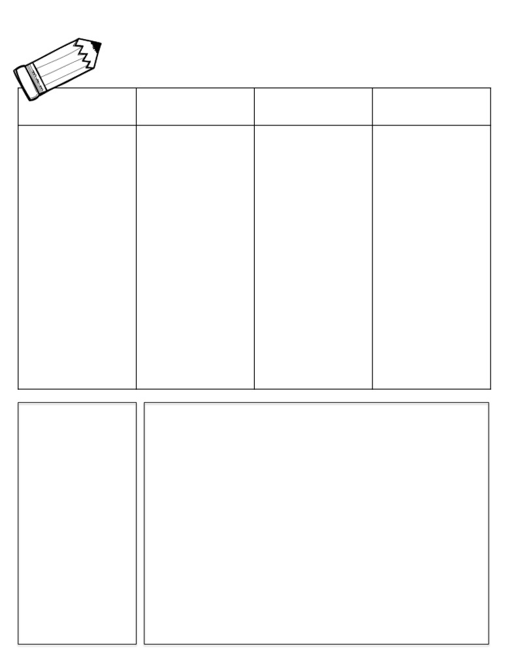
Week of October 10
Name:
Homework & News
MON.
TUES.
WED.
THURS.
☐ complete daily problems on math HW sheet
☐ study Memory Words for oral assessment
☐ study Memory and Pattern Words using Spelling Menu*
(1 a night)
*see attached
☐ complete daily problems on math HW sheet
☐ study Memory Words for oral assessment
☐ study Memory and Pattern Words using Spelling Menu*
(1 a night)
*see attached
☐ complete daily problems on math HW sheet
☐ study Memory Words for oral assessment
☐ study Memory and Pattern Words using Spelling Menu*
(1 a night)
*see attached
☐ study Memory and Pattern Words using Spelling Menu*
(1 a night)
*see attached
Test on Monday!!!
☐ Enjoy your long weekend!
Parent Initials
Parent Initials
Parent Initials
Student of the Week
Luke
Birthdays
Class Reminders
Students no longer need to bring in water bottles
Try the app, abc Pocket Phonics for work on letter formation and sounds
Place Spelling work in red folder to be checked
Don’t forget to READ!!!! It’s Read-a-thon time
Important Dates
10/13 Memory Word Oral Assessment
10/14 No School
10/17 Spelling Test

