Slide 1
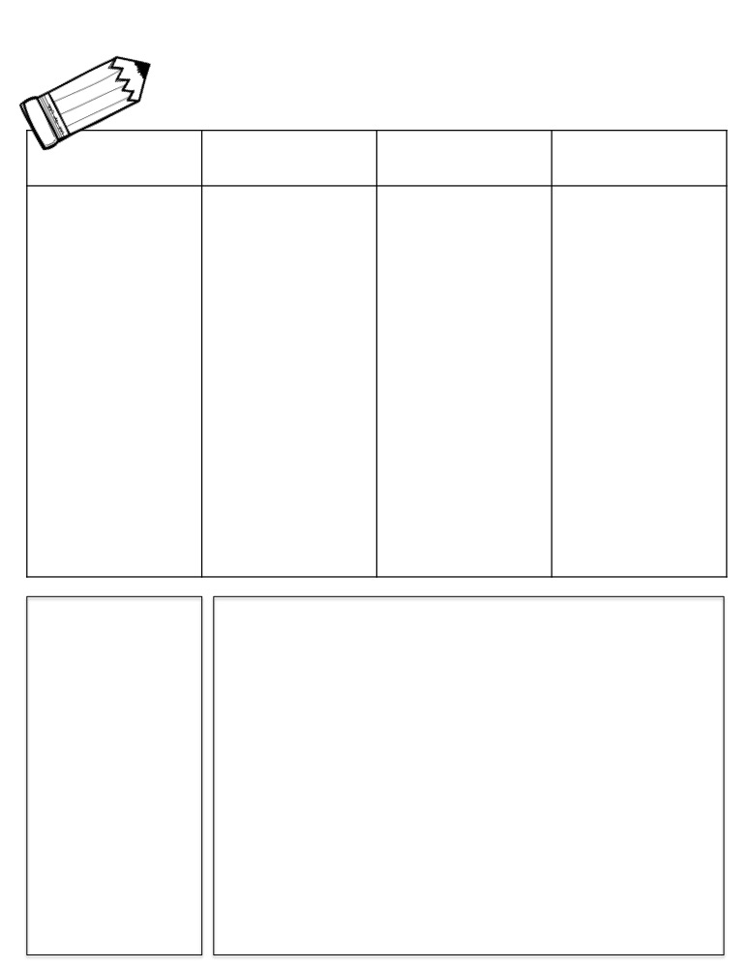
Week of October 31
Name:
Homework & News
MON.
TUES.
WED.
THURS.
☐ complete daily problems on math HW sheet
☐ XTRA Math Session
☐ Read online Super Kids story, Cluck–quiz on Friday
☐ study memory and pattern words: complete task from Spelling Menu
☐ complete daily problems on math HW sheet
☐ XTRA Math Session
☐ Read online Super Kids story, Cluck–quiz on Friday
☐ study memory and pattern words: complete task from Spelling Menu
☐ complete daily problems on math HW sheet
☐ XTRA Math Session
☐ Read online Super Kids story, Cluck–quiz on Friday
☐ study memory and pattern words: complete task from Spelling Menu
☐ complete daily problems on math HW sheet
☐ XTRA Math Session
☐ Read online Super Kids story, Cluck–quiz tomorrow
☐ study memory and pattern words: complete task from Spelling Menu
Parent Initials
Parent Initials
Parent Initials
Parent Initials
Student of the Week
Olivia
Birthdays
Class Reminders
Please keep all homework papers stapled together and return daily! Assignments not sent in daily are marked as a zero.
When completing spelling tasks, make sure to clearly state the title of the task, color box on menu and complete neatly.
Important Dates
11/2 Cogat Testing begins
11/3 Parent/Teacher Conferences
11/8 No School
11/10 No School-Conferences
11/11 No School

